Slide 1
Intro to
React
By Salmen Abbes

Slide 2
TABLE OF CONTENTS
What is React
Why use React
Overview of JSX
Setting up the environment
Create a React App
React Project Structure

Slide 3
01
What is React?

Slide 4

React? Hmm…
React is a JavaScript library for building user interfaces.
Developed by Facebook, React allows the creation of dynamic and interactive UIs.
React follows a component-based architecture, making it modular and reusable.

Slide 5
02
Why use React?

Slide 6
Because Why not?
React enhances UI development by providing a more structured and efficient approach.
Virtual DOM ensures optimal performance by minimizing unnecessary updates.
Strong community support and a vast ecosystem of libraries.

Slide 7
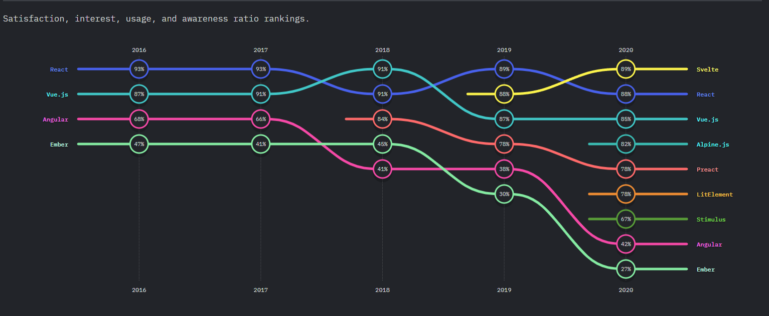

Slide 8
03
JSX Overview

Slide 9

JSX, Easy and COOL!
JSX (JavaScript XML) is a syntax extension for JavaScript that is used in React to describe the structure and appearance of user interface components. It allows developers to write HTML-like code directly within JavaScript, making it easier to create and manipulate UI elements.

Slide 10
EXAMPLE
import React from 'react';
function App() {
return (
<div>
<h1>Hello, World!</h1>
<p>Welcome to React.</p>
</div>
);
}
Notes:
In the example above, we use JSX to define the structure of a React component. The <div> element acts as a container for the <h1> and <p> elements, which represent the heading and paragraph of the component's UI.
By using JSX, we can easily create and manipulate complex UI structures in a more intuitive and efficient way.

Slide 11
04
Setting up React environment

Slide 12



NodeJS is the Key!
NodeJS
npm
IDE
Node.js is a JavaScript runtime that allows server-side execution.
Node Package Manager manages packages and dependencies.
Choose a suitable IDE for React development, such as Visual Studio Code, Atom, or Sublime Text.

Slide 13
How to do it?
Download NodeJS
Install it
It’s Simple!
Create a folder
Start
Head to «nodejs.org» and download a suitable version.
Install the downloaded file. NodeJs comes already with «npm»
Follow the next steps
Create a Blank folder to hold all the mess.
Open your IDE and start producing

Slide 14
05
Create A React App

Slide 15
It’s called “create-react-app”
Simple
Easy
Fast
Simplifies the development process by providing a pre-configured setup.
Run a single command to create a new React app
Create React App is a tool to quickly set up a new React project

Slide 16
How does it Work?
React
App
Name
Terminal
Node
Package
Execute
Command to
Create a sample
React project

Slide 17
06
React Project Structure

Slide 18
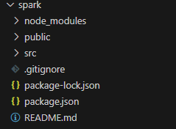
Exploring the structure of a React project

Slide 19
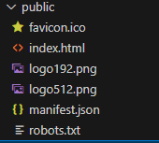
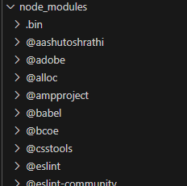
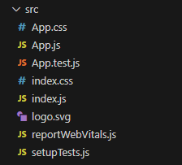

Detailed Sight:
Notes:
src folder:
This is the heart of your React application, where the source code resides.
It houses components, styles, and other assets necessary for your application.
src/index.js file:
JavaScript entry point for your React application.
Imports ReactDOM to render the main component into the HTML root.
Registers a service worker for progressive web app features.
src/App.js file:
Default React component created by Create React App.
Demonstrates the basic structure of a functional React component.
src/App.css file:
Default stylesheet for the App.js component.
Illustrates how CSS can be integrated with React components.
src/logo.svg file:
SVG image file included for demonstration purposes.
Can be replaced or removed based on your project needs.
src/App.test.js file:
File for testing the App.js component.
Encourages writing tests for React components to ensure code reliability.
src/setupTests.js file:
Configuration file for setting up testing libraries.
Provides a foundation for writing tests in your React application.
src/reportWebVitals.js file:
Measures web vitals performance metrics for your application.
Helps track and report real user experiences, aiding in optimization efforts.
public folder:
Houses the static assets like HTML files, images, and favicon.
The index.html file here is the entry point for your React application.
public/manifest.json file:
Purpose: Enables Progressive Web App (PWA) features.
Content: Metadata for the web app, affecting how it appears and functions.
Key Properties: Name, start URL, display mode, icons.
public/robots.txt file:
Purpose: Guides web crawlers on how to interact with the site.
Content: Directives for search engine spiders, specifying crawl permissions.
Common Directives: User-agent, Disallow, Allow, Sitemap.

Slide 20
THANKS!

